Slide 1


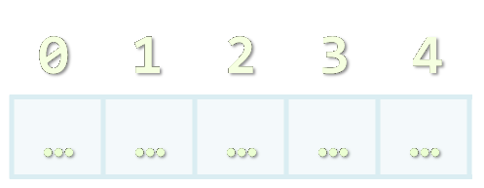

Arrays, Lists, Stacks, Queues
Processing Sequences of Elements
SoftUni Team
Technical Trainers
Software University
http://softuni.bg

Slide 2


Table of Contents
Declaring and Creating Arrays
Accessing Array Elements
Reading and Printing Arrays at the Console
Iterating over Arrays Using for and foreach
Resizable Arrays: List<T>
Other Structures: Stack<T> and Queue<T>
LINQ Extension Methods for Collections

Slide 3


Declaring and Creating Arrays

Slide 4

What are Arrays?
An array is a sequence of elements
All elements are of the same type
The order of the elements is fixed
Has fixed size (Array.Length)
Element of an array
0 1 2 3 4
Element index (position)
Array of 5 elements
… | … | … | … | …

Slide 5

Declaring Arrays
Declaration defines the type of the elements
Square brackets [] mean "array"
Examples:
Declaring array of integers:
Declaring array of strings:
int[] intArr;
string[] stringArr;

Slide 6

Creating Arrays
Use the operator new
Specify the array length (fixed number of elements)
Example: creating (allocating) array of 5 integers:
myIntArray = new int[5];
0 1 2 3 4
myIntArray
… | … | … | … | …
managed heap
(dynamic memory)

Slide 7
Creating and Initializing Arrays
Creating and initializing can be done in a single statement:
The new operator is not required when using curly brackets initialization
myIntArray = {1, 2, 3, 4, 5};
0 1 2 3 4
myIntArray
1 | 2 | 3 | 4 | 5
managed heap
(dynamic memory)

Slide 8

Creating Array – Example
Creating an array to hold the names of the days of the week
string[] daysOfWeek =
{
"Monday",
"Tuesday",
"Wednesday",
"Thursday",
"Friday",
"Saturday",
"Sunday"
};

Slide 9

Accessing Array Elements
Read and Modify Elements by Index

Slide 10
How to Access Array Element?
Array elements are accessed
Using the square brackets operator [] (indexer)
Array indexer takes element’s index as parameter
The first element has index 0
The last element has index Length-1
Elements can be retrieved and changed by the [] operator
string[] arr = new string[2];
string arr[1] = "Maria";
arr[0] = arr[1];

Slide 11
Accessing Array Elements – Examples
string[] towns = { "Sofia", "Varna", "Bourgas" };
Console.WriteLine(towns); // System.String[]
Console.WriteLine(towns.Length); // 3
Console.WriteLine(towns[0]); // Sofia
Console.WriteLine(string.Join(", ", towns)); // Sofia, Varna, Bourgas
towns[0] = "Pleven";
towns[2] = null;
Console.WriteLine(string.Join(", ", towns)); // Pleven, Varna,
Console.WriteLine(towns[3]); // IndexOutOfRangeException
towns.Length = 4; // Length is read-only

Slide 12

Accessing Elements By Index
Live Demo

Slide 13

Arrays: Input and Output
Reading and Printing Arrays on the Console

Slide 14
Reading Arrays From the Console
First, read from the console the length of the array
Next, create the array of given size and read its elements in a for loop
int n = int.Parse(Console.ReadLine());
int[] arr = new int[n];
for (int i=0; i<n; i++)
{
arr[i] = int.Parse(Console.ReadLine());
}

Slide 15
Printing Arrays on the Console
Process all elements of the array
Print each element to the console
Separate elements with white space or a new line
string[] array = {"one", "two", "three"};
// Process all elements of the array
for (int index = 0; index < array.Length; index++)
{
// Print each element on a separate line
Console.WriteLine(element[{0}] = {1}",
index, array[index]);
}

Slide 16
Printing Arrays with String.Join(…)
Use string.Join(separator, collection) to print an array:
int[] arr = { 1, 2, 3 };
Console.WriteLine(string.Join(", ", arr)); // 1, 2, 3
string[] strings = { "one", "two", "three" };
Console.WriteLine(string.Join("-", strings)); // one-two-three

Slide 17
Printing Arrays
Live Demo

Slide 18
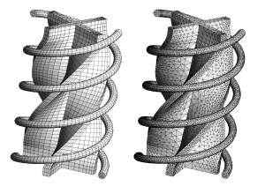
Processing Array Elements Using for and foreach

Slide 19
Processing Arrays: for Statement
Use for loop to process an array when
Need to keep track of the index
Processing is not strictly sequential from the first to the last
In the loop body use the element at the loop index (array[index]):
for (int index = 0; index < array.Length; index++)
{
squares[index] = array[index] * array[index];
}

Slide 20
Processing Arrays Using for Loop – Examples
Printing array of integers in reversed order:
Initialize array elements with their index:
int[] arr = new int[] {1, 2, 3, 4, 5};
Console.WriteLine("Reversed: ");
for (int i = array.Length - 1; i >= 0; i--)
Console.Write(array[i] + " ");
// Result: 5 4 3 2 1
for (int index = 0; index < array.Length; index++)
{
array[index] = index;
}

Slide 21

Processing Arrays: foreach
How the foreach loop works?
type – the type of the element
value – local name of a variable
collection – the collection/array to iterate
Used when no indexing is needed
All elements are accessed sequentially
Elements can not be modified (read only)
foreach (type value in collection)

Slide 22
Processing Arrays Using foreach – Example
Print all elements of a string[] array:
string[] capitals =
{
"Sofia",
"Washington",
"London",
"Paris"
};
foreach (string capital in capitals)
{
Console.WriteLine(capital);
}

Slide 23
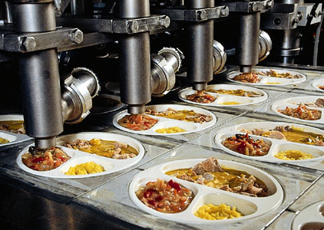
Processing Arrays
Live Demo

Slide 24
Static Methods in the Array Class
Array.Clear(arr, index, length) – deletes all elements
Array.ConvertAll(arr, convertFunction)
Converts an array of one type to an array of another type
Array.IndexOf(arr, item)
Finds an item in array (returns the first occurrence index or -1)
Array.Reverse() – reverses the elements order
Array.Sort() – sorts an array in increasing order

Slide 25

Array Static Methods
Live Demo

Slide 26

Exercises in Class

Slide 27
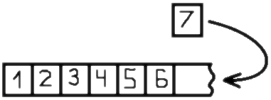

Resizable Arrays
List<T>

Slide 28
Lists (Resizable Arrays)
List<T> – array that can resize dynamically
When adding or removing elements
Also have indexers [] (like arrays)
T is the type for the list elements
E.g. List<int> will hold integers, List<object> will hold objects
Basic properties
Count – returns the current size of the list
Capacity – returns the current capacity of the list

Slide 29
List Example
This code:
Is like this:
The main difference
The number of elements in List<T> is variable
List<int> intList = new List<int>();
for (int i = 0; i < 5; i++)
intList.Add(i);
int[] intArray = new int[5];
for (int i = 0; i < 5; i++)
intArray[i] = i;

Slide 30


Lists <T>
Live Demo

Slide 31
How The List<T> Works? (1)
Why adding new elements is slow?
When adding n elements in List<T> it resizes itself log₍₂₎n times instead of n
Initially a new List<T> has size of 0 elements
Counter for total capacity (Capacity)
Counter for number of used capacity (Count)
Add element → Count becomes 1 and Capacity becomes 16

Slide 32
How The List<T> Works? (2)
Initially the List<T> is empty
When adding new elements it is being resized
But not every time
Only when needed
Lets have a list with 3 elements
It looks like this:
When we add a new element it is appended to the end
Adding a fifth element doubles the Capacity of the list

Slide 33


Resizing Lists
Live Demo

Slide 34
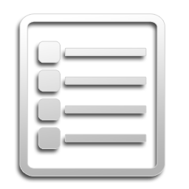
List<T> Methods
Brief Overview

Slide 35
List<T> Methods (1)
List<T>.Add(item) – adds an item to the end
List<T>.AddRange(items) – adds many items at the end
List<T>.Clear() – clears the list
List<T>.IndexOf(item) – search for item
Return the first occurrence index or -1
List<T>.Insert(item, index) – inserts an item at position
List<T>.InsertRange(items, index)
Inserts many items at specified position

Slide 36
List<T> Methods (2)
List<T>.Remove()
Removes the first occurrence of a specific item
List<T>.RemoveAt()
Removes the element at the specified index
List<T>.Reverse()
List<T>.Sort()
List<T>.ToArray()

Slide 37
Stack<T>
Represents a variable size last-in-first-out (LIFO) collection of instances of the same specified type.
Has the following methods and properties:
Count – the number of elements in the Stack<T>
Peek() – check the value of the last element
Pop() – return the last element and remove it from the Stack<T>
Push() – add an element to the Stack<T>
ToArray() – converts list to array
Contains() – determines whether an element is in the Stack<T>

Slide 38

Working with Stacks
Live Demo

Slide 39
Queue<T>
Represents a first-in, first-out (FIFO) collection of objects. Has the following methods and properties:
Count – the number of elements in the Queue<T>
Peek() – check the value of the first element
Dequeue() – return the first element and remove it from the Queue<T>
Enqueue() – add an element to the Queue<T>
ToArray()
Contains() - determines whether an element is in the Queue<T>

Slide 40
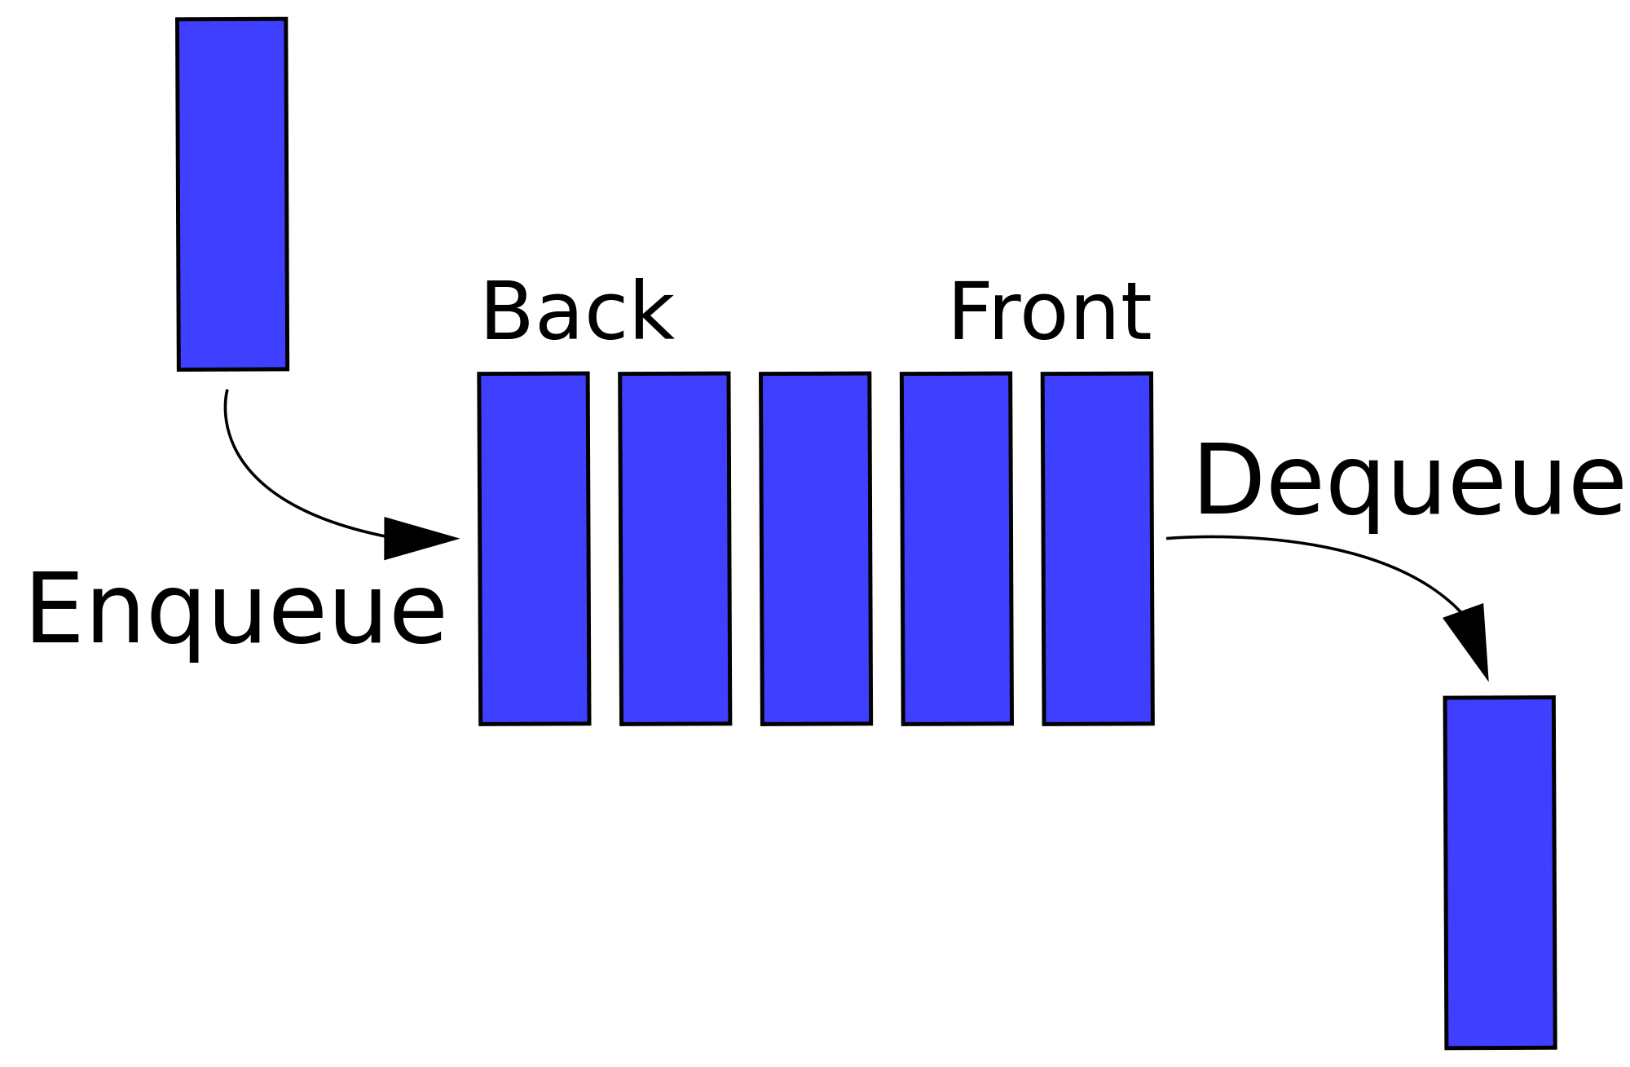
Queue<T>
Live Demo

Slide 41

LINQ Extension Methods for Collections
Brief Overview

Slide 42
Using System.LINQ with collections
What are extension methods?
Provide additional functionality to existing types
How to use them?
Add the System.Linq using directive
Call them as you call a regular instance method
var array = {1, 2, 3, 4, 5};
Console.WriteLine(array.Sum()); // 15

Slide 43
LINQ Extension Methods
Distinct() – returns distinct elements from a sequence by using the default equality comparer
First() and FirstOrDefault()
Intersect() and Union()
Min(), Max(), Sum () and Average()
Skip() – bypasses a specified number of elements in a sequence and then returns the remaining elements
Take() – returns a specified number of contiguous elements from the start of a sequence

Slide 44
LINQ Extension Methods
Live Demo

Slide 45
Summary
Arrays are a fixed-length sequences of elements of the same type
Array elements are accessible by index (can be read and modified)
Iteration over array elements with for and foreach loops
List<T> holds resizable arrays
Good when we don't know the number of elements initially
Stack<T> and Queue<T>
LINQ Extension methods provide additional functionality for working with such collections

Slide 46
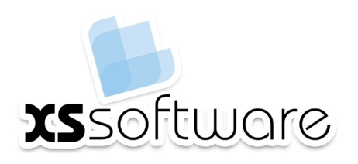








Arrays, Lists, Stack, Queue
https://softuni.bg/courses/advanced-csharp

Slide 47
License
This course (slides, examples, demos, videos, homework, etc.) is licensed under the "Creative Commons Attribution-NonCommercial-ShareAlike 4.0 International" license
Attribution: this work may contain portions from
"Fundamentals of Computer Programming with C#" book by Svetlin Nakov & Co. under CC-BY-SA license
"C# Part I" course by Telerik Academy under CC-BY-NC-SA license
"C# Part II" course by Telerik Academy under CC-BY-NC-SA license

Slide 48





Free Trainings @ Software University
Software University Foundation – softuni.org
Software University – High-Quality Education, Profession and Job for Software Developers
softuni.bg
Software University @ Facebook
facebook.com/SoftwareUniversity
Software University @ YouTube
youtube.com/SoftwareUniversity
Software University Forums – forum.softuni.bg

